Slide 1

BIG DATA ANALYTICS FOR COMPETITIVE ADVANTAGE
FINAL TERM PROJECT – Porter Delivery Time Estimation

Slide 2
Group 5 Team Members:-
Ramya Jampani (801307121)
Himanshi Khatri (801305595)
Chetan Subhash Chunduru (801306998)
Revanth Kumar Galla (801314883)
Satya Sai Rajesh Parvatareddy (801328224)

Slide 3
Problem Statement
The "Porter Delivery Time Estimation" dataset presents a valuable opportunity for businesses to utilize existing data in order to extract insights and arrive at well-informed decisions. The dataset can be analyzed and valuable insights can be derived by utilizing domain knowledge related to the food delivery industry, logistics, and customer preferences. Through an analysis of the variables that impact delivery time, discernment of patterns and trends in order volume, customer satisfaction, delivery performance, and vendor performance, enterprises can optimize their operational processes, enhance their customer service, and augment their competitive edge.
The interpretation of data and discovery of significant insights can be facilitated through the utilization of domain knowledge in fields such as transportation and logistics, customer behavior, and market trends. An instance of optimization for delivery routes and schedules in businesses can be achieved by comprehending the influence of weather conditions, traffic patterns, and distance on delivery time. Acquiring an understanding of customer preferences, including peak hours and days, can aid businesses in effectively strategizing their resource allocation and operational procedures. Familiarity with market trends and seasonal patterns can assist enterprises in adapting their tactics and advertising campaigns to accommodate evolving consumer preferences.
Dataset can be accessed at :-
https://www.kaggle.com/datasets/ranitsarkar01/porter-delivery-time-estimation

Slide 4
Attributes Explained
market id: integer id for the market where the restaurant lies
created at: the timestamp at which the order was placed
actual delivery time: the timestamp when the order was delivered
store_primary_category: category for the restaurant
order protocol: integer code value for order protocol(how the order was placed le: through porter, call to restaurant, pre booked, third part etc)
total items subtotal: final price of the order
num_distinct items: the number of distinct items in the order
actual delivery time: the timestamp when the order was delivered
store_primary_category: category for the restaurant
order protocol: integer code value for order protocol(how the order was placed le: through porter, call to restaurant, pre booked, third part etc)
total items subtotal: final price of the order
num_distinct items: the number of distinct items in the order
min_item_price: price of the cheapest item in the order
max_item_price: price of the costliest item in order
total_onshift_partners: number of delivery partners on duty at the time order was placed
total_busy_partners: number of delivery partners attending to other tasks
total outstanding_orders: total number of orders to be fulfilled at the moment

Slide 5
Data Understanding
The dataset titled "Porter Delivery Time Estimation" available on Kaggle provides a prospect for data-driven analysis in the realm of food delivery by presenting a business problem. Food delivery enterprises, including restaurants, cafes, and food delivery platforms, encounter the difficulty of accurately predicting and controlling delivery durations to ensure a gratifying encounter for their clientele. Precise estimation of delivery time is critical for fulfilling customer demands, guaranteeing punctual deliveries, and upholding customer contentment.
The utilization of domain expertise and examination of the "Porter Delivery Time Estimation" dataset offers a prospect for enhancing delivery time estimation, streamlining operations, augmenting customer contentment, and attaining a competitive edge in the food delivery sector.

Slide 6
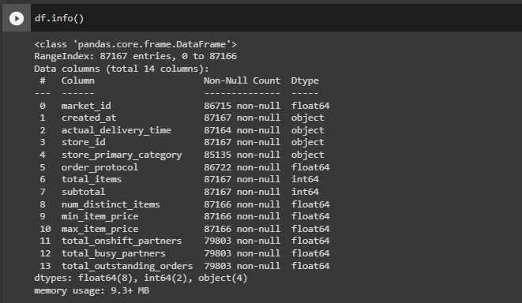
Exploratory Data Analysis
We have 87,167 rows with 13 features
df.info(), gives the information type of the dataset like the column type and how many non null values are present in the column

Slide 7
Exploratory Data Analysis
During the exploratory data analysis on the Porter dataset using AWS SageMaker Notebook instances, several functions were developed to understand the data. Here's a summary of the functions:
check_missing_values: This function determines the presence or absence of missing values (null values) in the dataset. It produces a binary output indicating if null values are present. If there are missing values, the function also displays the proportion of missing values in each column.
check_duplicates: The purpose of this function is to identify rows in the dataset that are completely identical or duplicated. It provides a boolean output indicating if identical rows exist in the dataset. Additionally, if there are duplicated rows, the function displays the count of such duplicated rows.
get_statistics: This function computes summary statistics for the numerical columns of the dataset. The statistics include measures such as mean, median, mode, standard deviation, minimum and maximum values, and quartiles. The output of this function is a dataframe containing the calculated statistics.
get_histogram: This function utilizes the quantitative variables in the dataset to create histograms. It utilizes the matplotlib library to generate the histograms, which provide visual representations of the distribution of the data.
One-hot encoding:- We have also converted the categorical columns to numerical cols for better results.

Slide 8
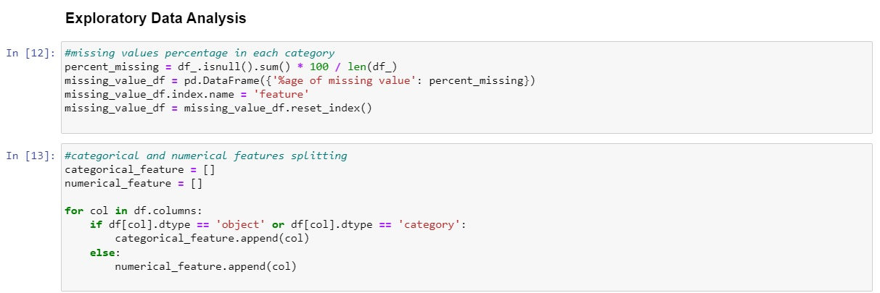
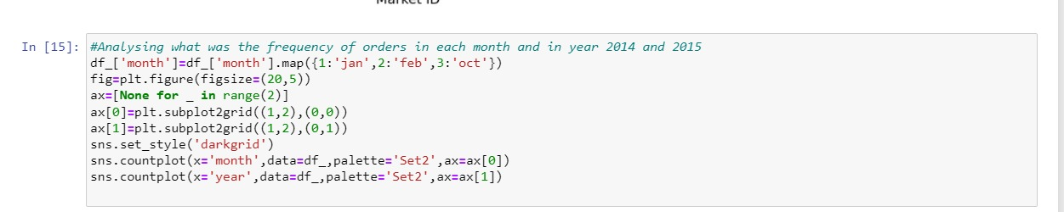
Exploratory Data Analysis

Slide 9
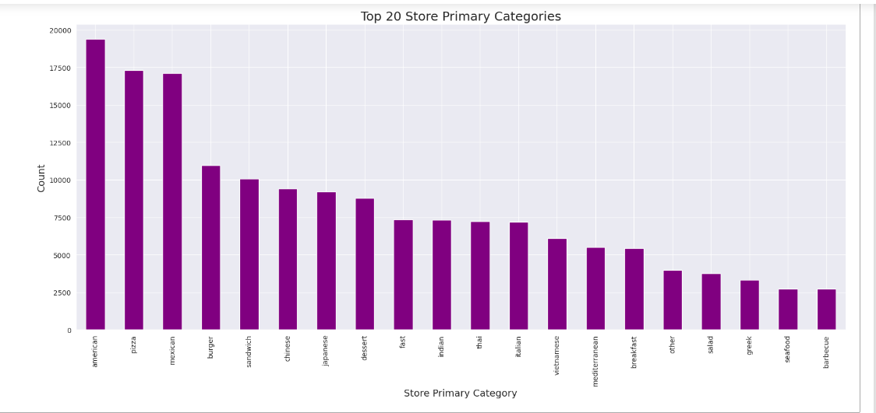
Visualizations
This graph shows us the top 20 Store Primary Categories

Slide 10
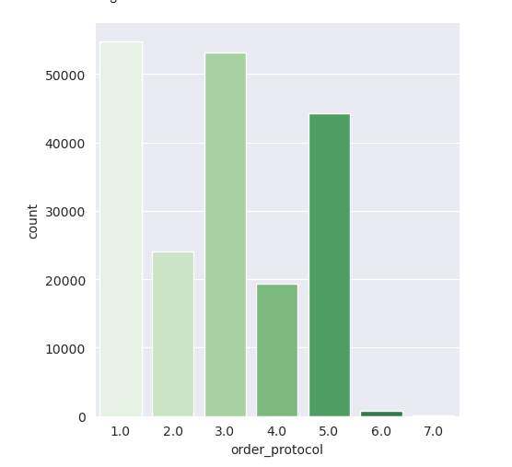
Visualizations
This graph shows us the count distribution of various order protocols i.e how they have placed the order

Slide 11
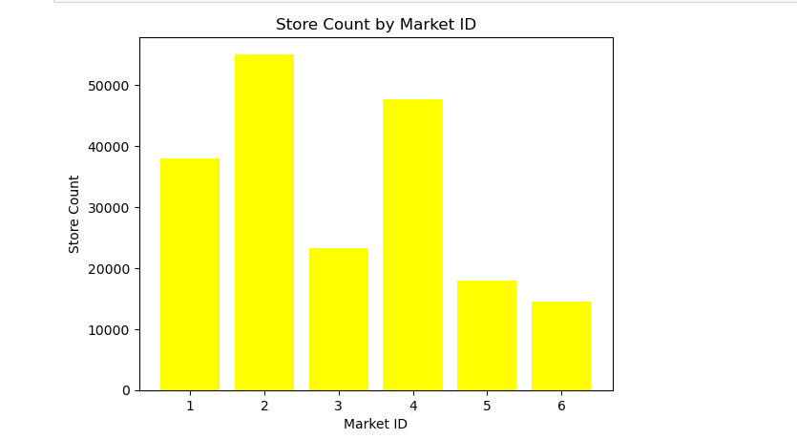
Visualizations
This visualization shows us the number of stores in each Market

Slide 12
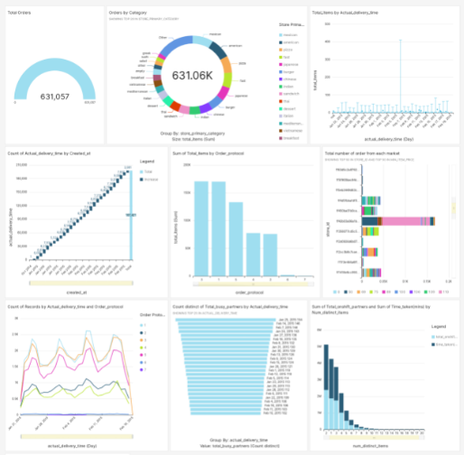
Dashboard
This is the dashboard we have made using the quick sight which gives us various important insights.

Slide 13
Data Preparation
The remove_outliers function is designed to eliminate any outliers present in the dataset. The z-score technique is employed to detect and eliminate outliers from the dataset. The input parameters for the function include a dataframe and a threshold value. In statistical analysis, an outlier is identified as any data point that exhibits a z-score exceeding the threshold value, and subsequently excluded from the dataset.
The impute_missing_values function is designed to address missing values in a dataset by utilizing the mean value of the corresponding column for imputation purposes. The function accepts a dataframe as an argument and proceeds to substitute any missing values with the mean value of the corresponding column.
The normalize_data function performs z-score normalization on the dataset to normalize the data. The function accepts a dataframe as an argument and produces a normalized dataframe as output. The z-score normalization technique is utilized to standardize data by performing two operations on each column: subtracting the mean value and dividing by the standard deviation.

Slide 14
Machine Learning & AWS
For analytics and machine learning, Amazon Machine Learning tools like SageMaker are employed.The datasets schema is carefully reviewed in order to use the most effective ML tools on it and get the most accurate results. Finally, the findings are obtained using the Amazon SageMaker. We have used Quick Sight for building the dashbaord
XGB Regressor:-
The XGBRegressor model is applicable in diverse regression scenarios, including but not limited to forecasting housing prices, stock prices, and customer lifetime value. In order to utilize XGBRegressor, it is necessary to appropriately format the data and subsequently train the model through implementation of the fit method. After completing the training process, the predict method can be employed to generate predictions on novel data. The model offers a multitude of hyperparameters that can be optimized to enhance its performance, including the quantity of trees, learning rate, and maximum tree depth
The XGBoost regressor is imported from the xgboost library.An XGBoost regressor model is created with specified hyperparameters (max_depth=3, learning_rate=0.1, and n_estimators=100).The model is trained using the training data (X_train and y_train).Predictions are made on the test data (X_test) using the trained model, and the predicted values are stored in y_pred.Evaluation metrics, mean absolute error (mae) and R-squared score (r2), are calculated using the predicted values and the actual target values (y_test).Finally, the MAE and R-squared score are printed to assess the performance of the model.

Slide 15
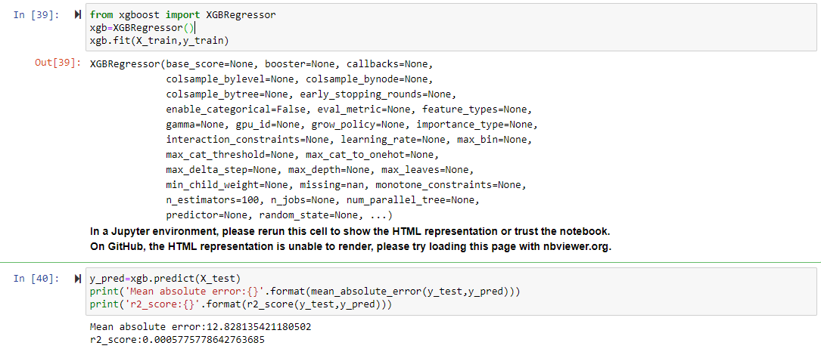
Evaluation & Optimization
We had trained XGBRegressor and also used the mean_absolute_error() and r2_score() functions to evaluate the model.
since the performance of the model needs to be verified all the time. This is how the model is constantly under evaluation

Slide 16
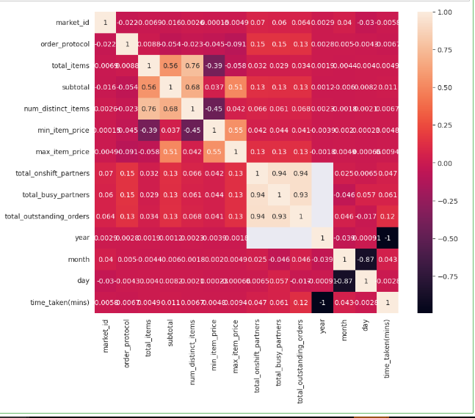
Results
The correlation graph shows a heatmap where each cell represents the correlation coefficient between two variables. The correlation coefficient measures the strength and direction of the linear relationship between two variables. It ranges from -1 to 1, with -1 indicating a strong negative correlation, 0 indicating no correlation, and 1 indicating a strong positive correlation.
By visualizing the correlation matrix, you can identify patterns and dependencies between variables. High positive correlations (values close to 1) suggest that the variables are positively related, meaning they tend to increase or decrease together. High negative correlations (values close to -1) indicate a negative relationship, where one variable tends to increase while the other decreases. A correlation close to 0 suggests no linear relationship between the variables.

Slide 17
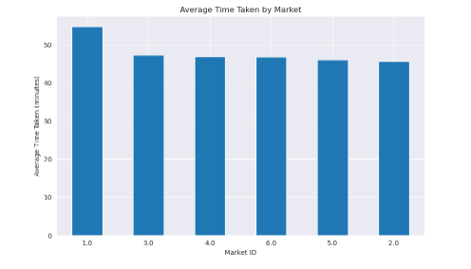
Results
Here, we have compared the average time taken by different Market

Slide 18
Conclusion
'created_at' and 'actual_delivery_time' columns were converted to datetime format for calculating the time taken for delivery.
Outliers in numerical features were identified and removed using box plots.
Negative values in 'min_item_price', 'total_outstanding_orders', 'total_onshift_partners', and 'total_busy_partners' were removed.
Missing values were imputed using appropriate methods: mode for categorical features and mean for numerical features.
The dataset was split into training and testing sets using a 70:30 ratio.
XGBoost algorithm was used for regression modeling.
Mean absolute error (MAE) and R2 score were used to evaluate the model's performance on the test data.
Percentage of missing values was calculated for each feature in the dataset.
Missing values were imputed for 'market_id', 'store_primary_category', 'order_protocol', 'total_onshift_partners', 'total_busy_partners', 'total_outstanding_orders', and 'time_taken(mins)' features.

Slide 19
Future Work
To improve the performance of the XGBoost model, we should perform hyperparameter tuning using techniques such grid search or random search to find the optimal combination of hyperparameters. Parameters like learning rate, maximum depth, number of estimators, subsample, and regularization can be tuned for a better results.
In addition, we can explore additional feature engineering techniques to increase the predictive power of model. This can include creating new features based on domain knowledge or transforming existing variables to capture non-linear relationships. Interactions between variables, polynomial features, or any other feature transformations can also be considered to capture more complex patterns in data.
To further improve the model's performance, we can experiment with ensemble modeling techniques such as bagging and boosting. Different ensemble methods, such as stacking or blending, can be tried to combine the predictions of multiple models.
To obtain more reliable estimates of the model's performance, cross validation techniques can be implemented. This can help assess the model's generalization ability and decrease the risk of overfitting.

Slide 20
Thankyou

